Slide 1
PROJ 200 – Group M
Schematic Capture and PCB Layout

Slide 2
PROJ 200 - Overview
Background
Project
Application APP you'll be using
Schematic
Simulation
PCB Layout

Slide 3
PROJ 200 - Background
Schematic or Circuit Diagram have been used for decades to describe in pictorial form the FUNCTIONAL representation of the Electrical/Electronic system that is designed
Printed Circuit Board or PCB is the TOPOGRAPHICAL or PHYSICAL LAYOUT of the functional diagram produced
Why Printed Circuit?
Historically wires used and mounting tabs to which components attached – Very Labour intensive
Paul Eisler is credited with being the inventor of the PCB. Plessey (UK) Pre-war in 1930s and USA manufacturers picked up post war
Originally in Resin Bonded paper RPB as the substrate later Resin bonded glass fibre took over AKA FR4 (FR = Flame retardant standard)

Slide 4
PROJ 200 - Project
Schematic or Circuit Diagram will be given. This is the FUNCTIONAL representation Electrical/Electronic system that you will be using.
All the parts will be on this diagram except TEST POINTS which you may find useful for both functional testing but also performance testing to check compliance with your design criteria and calculations.
You will be given some components, but you will need to select others based on your calculations
You will Simulate the circuit
You Will 'BreadBoard' the circuit – Test/Confirm
You will produce a PCB Layout and submit this for PCB manufacture
You will receive back a 'Bare' PCB to which you will populate with the components as supplied/gotten - Test/Confirm
Implement your assembled PCB

Slide 5
PROJ 200 - Application
PROTEUS is the application
Can perform all the required steps to eventually produce engineering files used in the production of a PCB
Gerber files – Text files vectorized data for the shapes required for the PCB layout, Drilling positions and drill sizes required even the component identification text – You'll need to use this to identify your design with group name etc.,
Simulation data either by virtual instruments or 'GRAPH' function to generate snapshots of different types such as a frequency domain plot or BODE plot

Slide 6
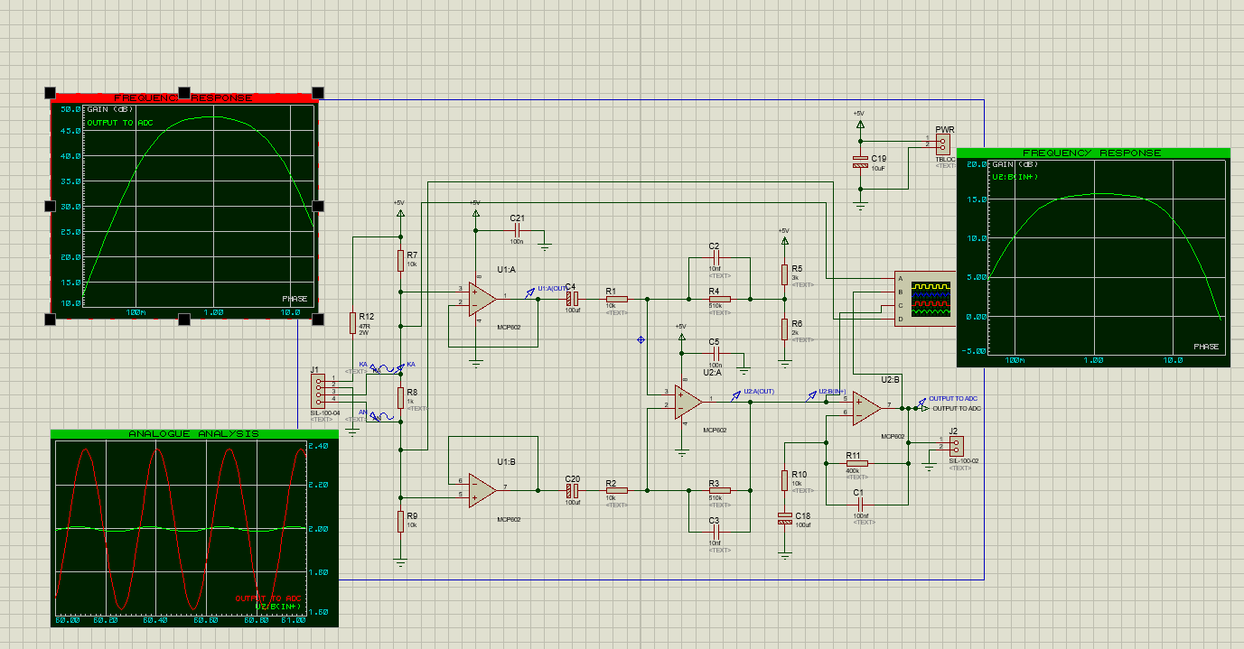
PROJ 200 - Schematic

Slide 7
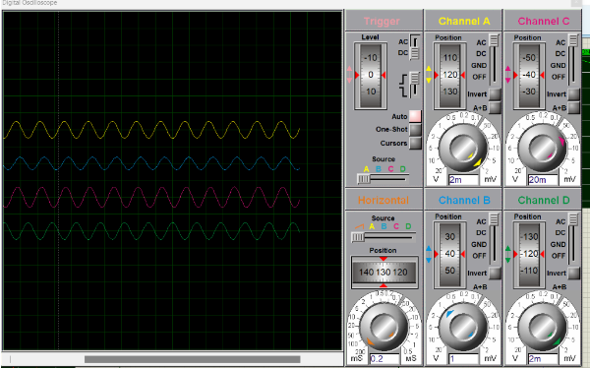
PROJ 200 - Simulation

Slide 8
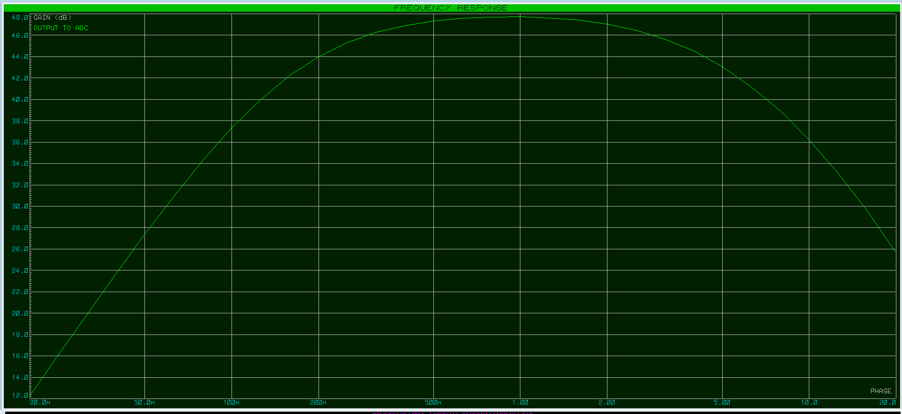
PROJ 200 - Simulation

Slide 9
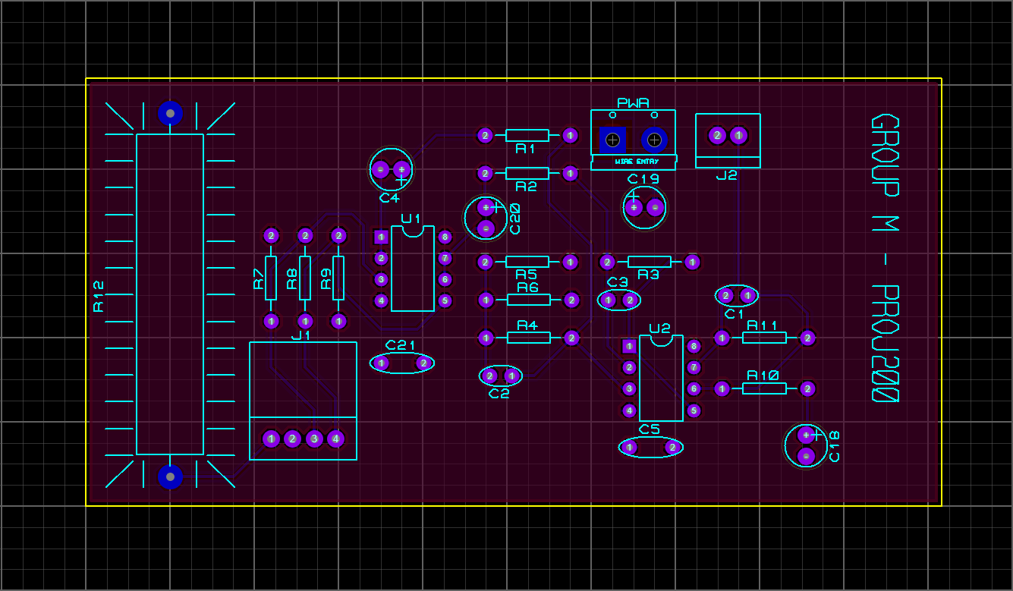
PROJ 200 – PCB Layout

Slide 10
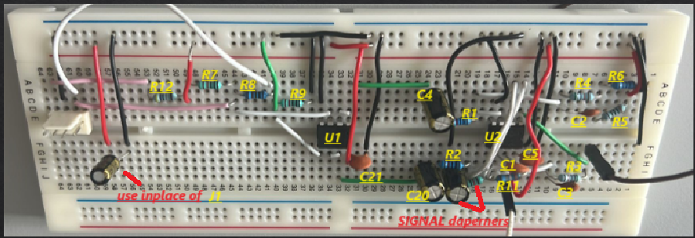
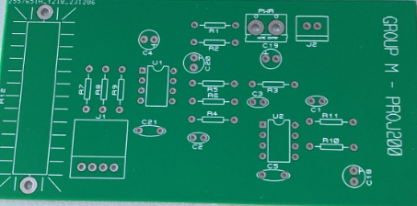
PROJ 200 – PCB Layout

Slide 11
PROJ 200 – PCB Layout (IPC Standards)
Fibre glass FR4 / Composite. 1oz (35μM) Copper
Conductor Current Ratings (DC and Low Frequency AC) 1oz Copper
Line Width | 0.50mm 0.015” | 0.70mm 0.028” | 1.00mm 0.040” | 1.50mm 0.060” | 2.00mm 0.080” | 2.50mm 0.100” | 3.00mm 0.125”
Temp. rise
10ºC | 1.30 | 1.75 | 2.25 | 3.10 | 4.00 | 4.30 | 5.00
20ºC | 1.80 | 2.30 | 3.00 | 4.10 | 5.00 | 6.00 | 7.00
30ºC | 2.30 | 3.50 | 3.80 | 5.00 | 6.60 | 7.50 | 9.00
45ºC | 2.70 | 3.80 | 4.30 | 6.00 | 8.00 | 9.00 | 10.50
60ºC | 3.00 | 4.50 | 5.00 | 7.00 | 9.00 | 10.00 | 12.00
Maximum permissible current for temperature rise shown

